Slide 2


Media DRD for KC-SA Extra Care New Born

Slide 3
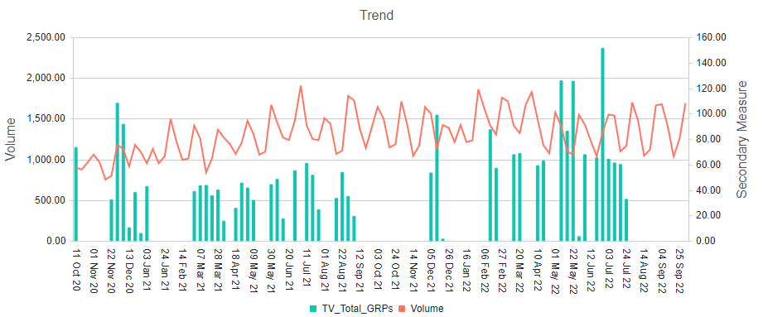
TV GRP’s vs Volume

Slide 4
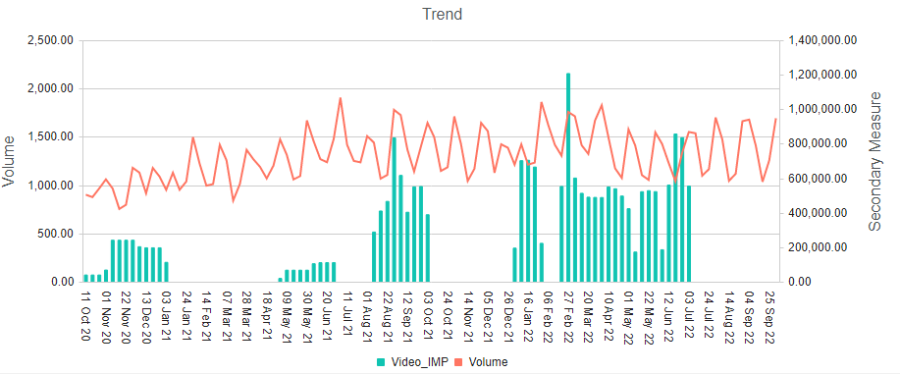
Video Impressions vs Volume

Slide 5
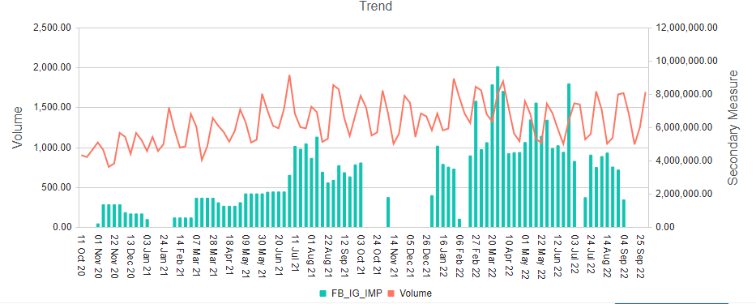
FB Impressions vs Volume

Slide 6
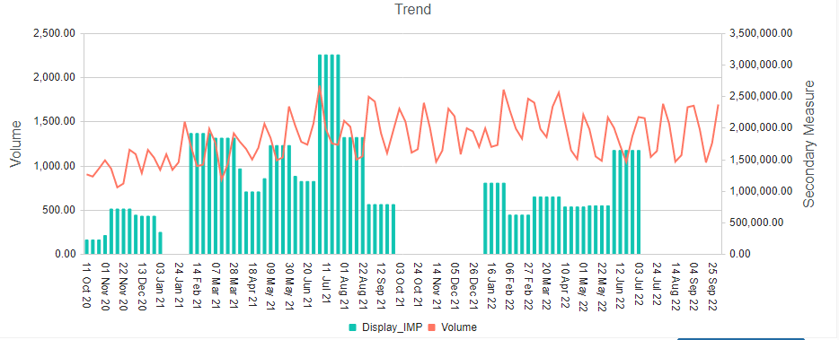
Display Impressions vs Volume

Slide 7
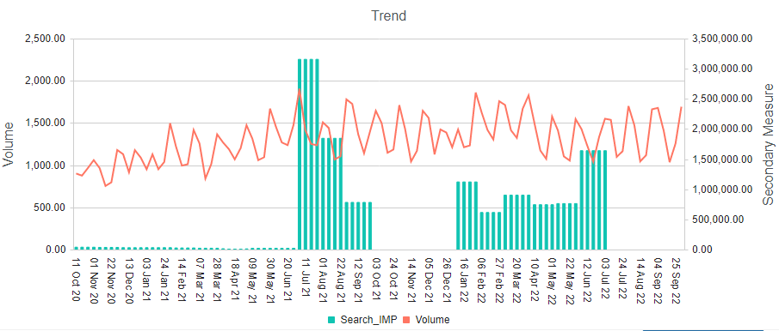
Search Impressions vs Volume

